Slide 1
CSCI241-001-45637 Computer Architecture and Assembly Language (Spring 2022)

Slide 3
Covid-19 Information
Review CMU Covid-19 information at www.coloradomesa.edu/covid-19 and follow the guidelines. Mask Guidelines can be found at https://www.coloradomesa.edu/covid-19/masking.html.
CMU administration recently (Jan 20) updated the mask guidelines to make wearing masks while attending class mandatory during the first two weeks of the Spring 2022 semester (Jan 24 – Feb 4). After that, the guidelines will be updated again, so check the website periodically.
You’re expected to provide your own masks, but I have a limited supply for a limited amount of time.
Disinfectant wipes are available so you may optionally disinfect your hands and workspace.
Be considerate of others and don’t attend class if you are exhibiting symptoms of any communicable illness.

Slide 4

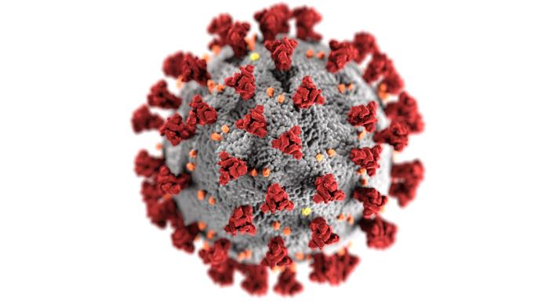
Coincidence?
Coronavirus
Sea Mine

Slide 5


Slide 6
D2L (Desire2Learn)
CMU’s online LMS (Learning Management System) (a.k.a, Brightspace)
Gateway to all aspects of this course.
You’ll be using D2L multiple times every day.
Important course announcements will appear on D2L, often in addition to CMU email (which you should check multiple times a day). You can install the Outlook app on your phone and get notifications whenever you receive a CMU email. (I highly recommend doing this.)

